Slide 1
NAMES
LAVEENA R
RUSHABH C
PREM R
SANDEEP D
MONISHA S M*
TEAM 5

Slide 2
HARDWARE FUNDAMENTALS

Slide 3
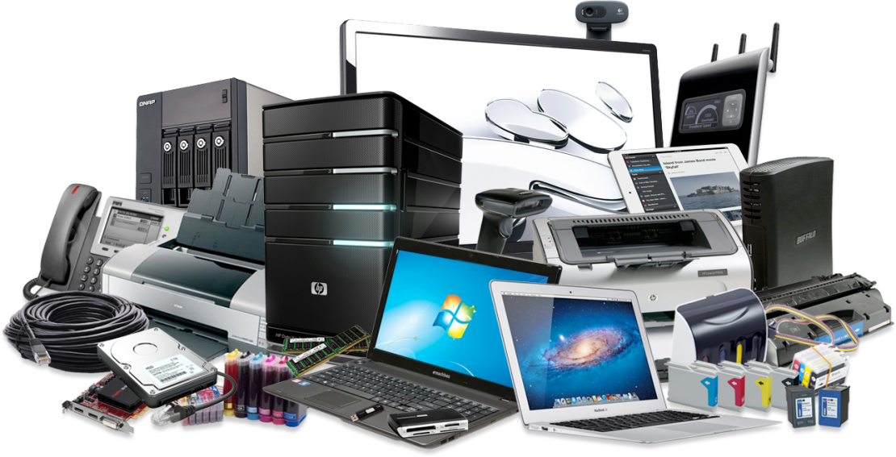
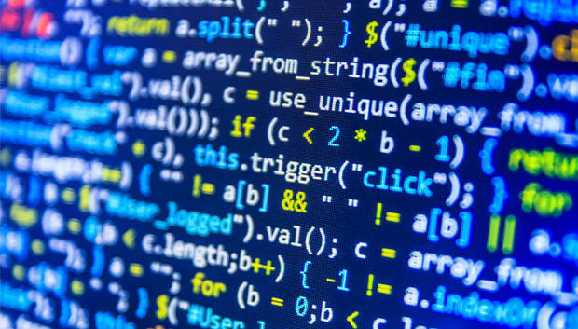
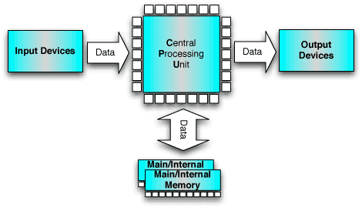
INTRODUCTION
tware :
Software is a collection of instructions that enable the user to interact with a computer
For example, without your Internet browser software, you could not surf the Internet
Hardware :
Hardware is best described as any physical component of a computer system that contains a circuit board, ICs, or other electronics
Software
Hardware
Block Diagram of Computer

Slide 4
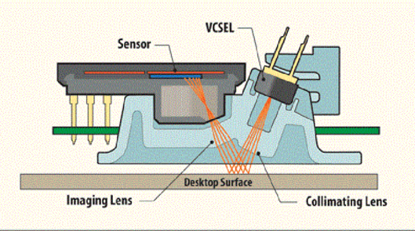
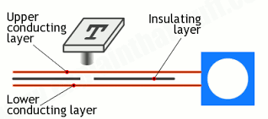
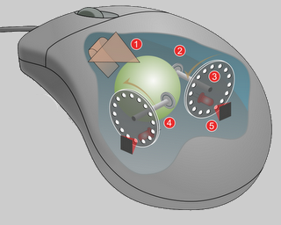
INPUT DEVICES
An input device is a piece of computer hardware equipment used to provide data and control signals to an information processing system such as a computer or information appliance.

Slide 5

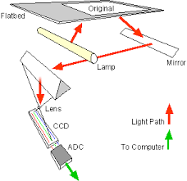
SCANNER
Flatbed scanner
Handheld scanner

Slide 6
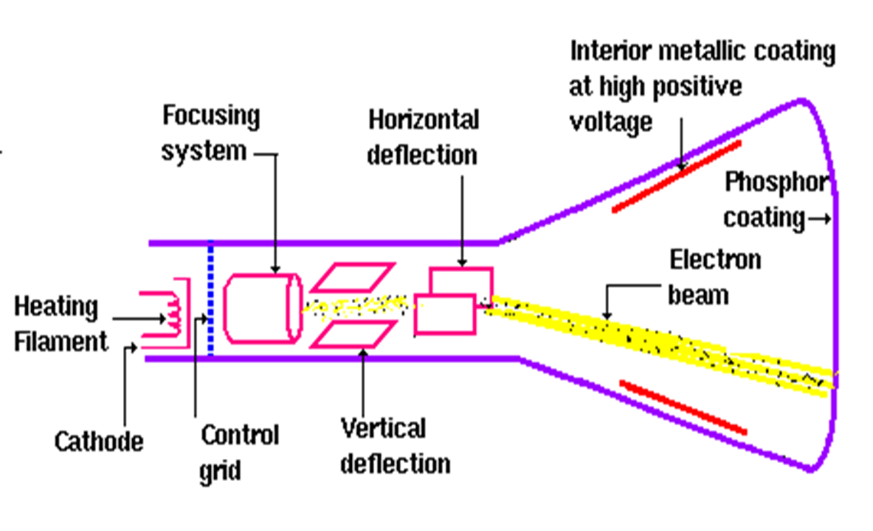
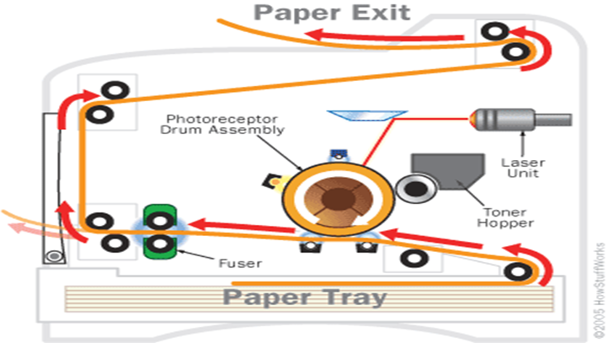
Laser printer
OUTPUT DEVICES
An output device is any device used to send data from a computer to another device or user.
Most computer data output that is meant for humans is in the form of audio or video.
Cathode Ray Tube

Slide 7
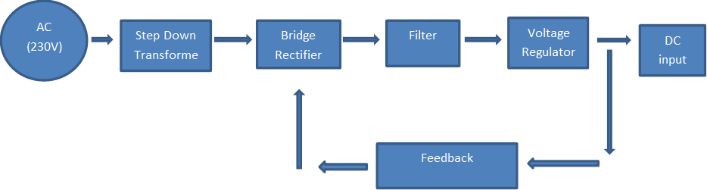
SMPS
A switched-mode power supply is an electronic power supply that incorporates a switching regulator to convert electrical power efficiently.

Slide 8
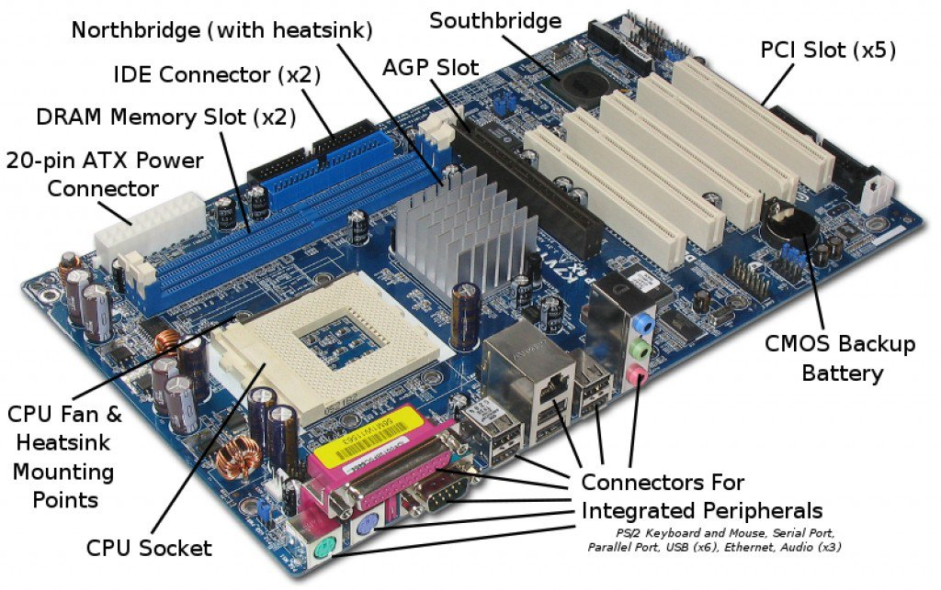
MOTHERBOARD
A printed circuit board containing the principal components of a computer or other device, with connectors for other circuit boards to be slotted into.

Slide 9
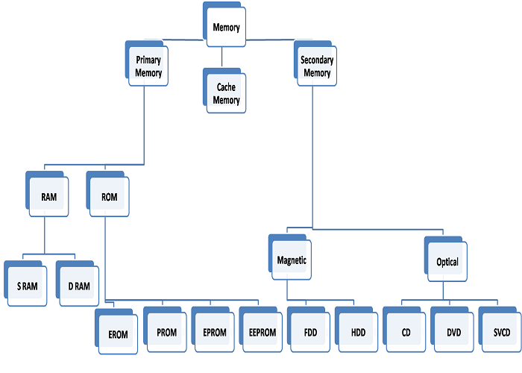
MEMORY AND STORAGE
The term memory identifies data storage that comes in the form of chips, and the word storage is used for memory that exists on tapes or disks.

Slide 10
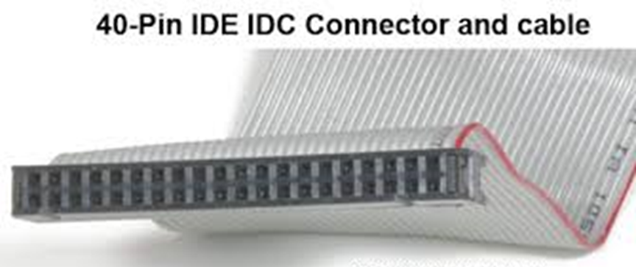
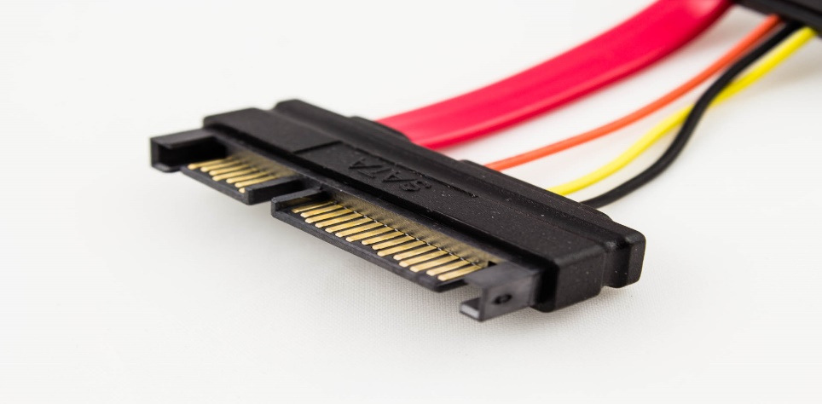
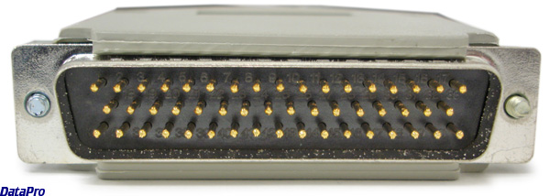
CONNECTORS
A simple device that physically links, couples, or connects, two things together.
IDE
SATA
SCSI

Slide 11
Windows
Fundamentals

Slide 12
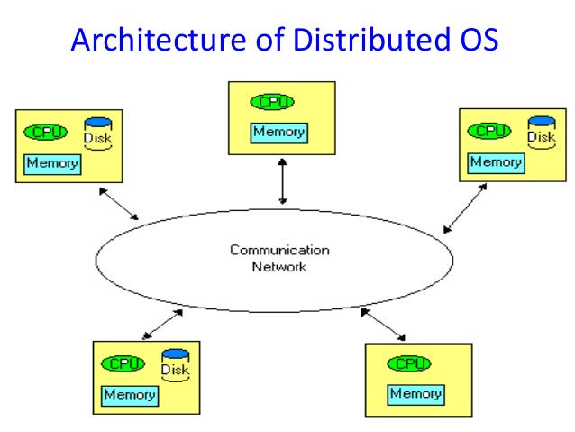
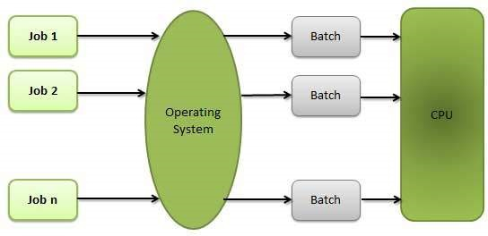
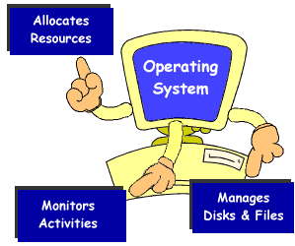
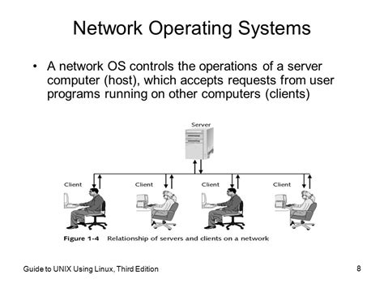
Types Of Operating System
Distributed Operating System
Batch Operating System
Multi Tasking Operating System
Network Operating System

Slide 13
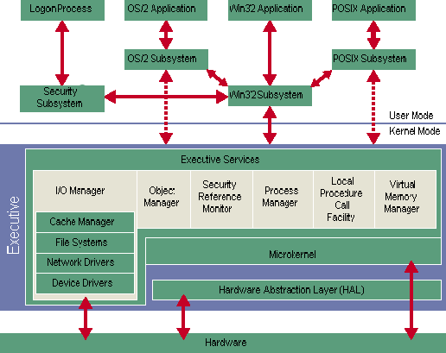
Kernel Architecture
Kernel is the core of the operating system.

Slide 14
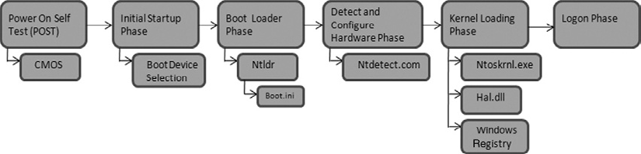
Booting Process

Slide 15
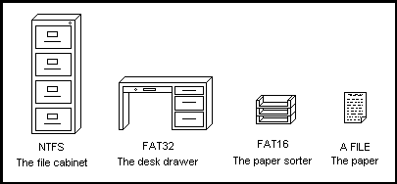
File System
A file is an object on a computer that stores data, information, settings, or commands used with a computer program.
Why we need File System?
Types of File System

Slide 16
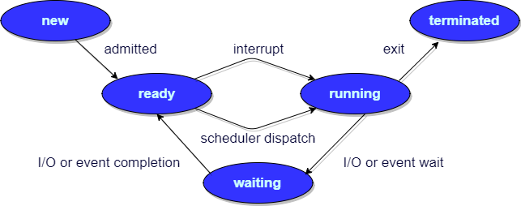
Process Management
What is PCB (Process Control Block) ?
What are the process states

Slide 17
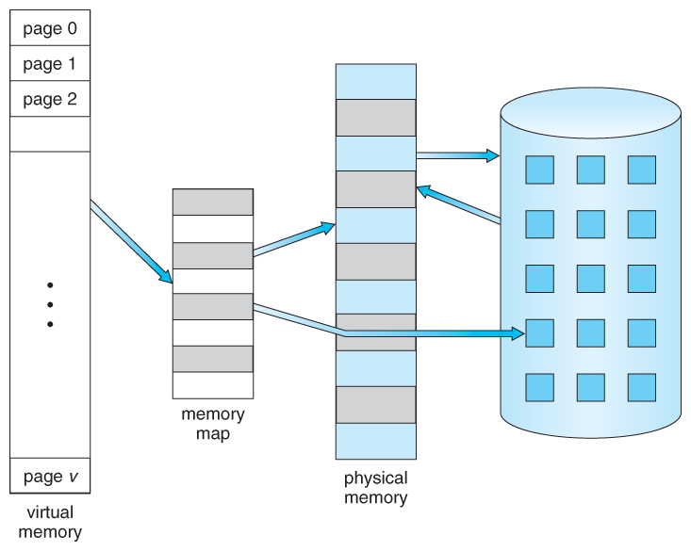
Memory management
What is Paging?
Why we need Paging?
What is Segmentation.
What is Virtual Memory?
What is Thrashing?
RAM
HDD

Slide 18
Linux
Fundamentals

Slide 19


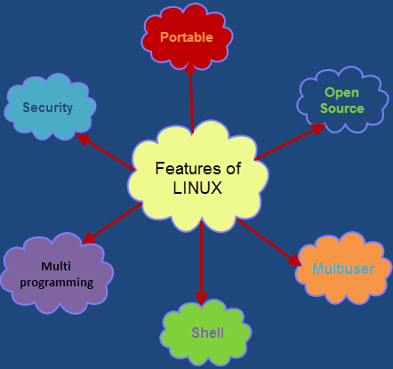

LINUX

Slide 20
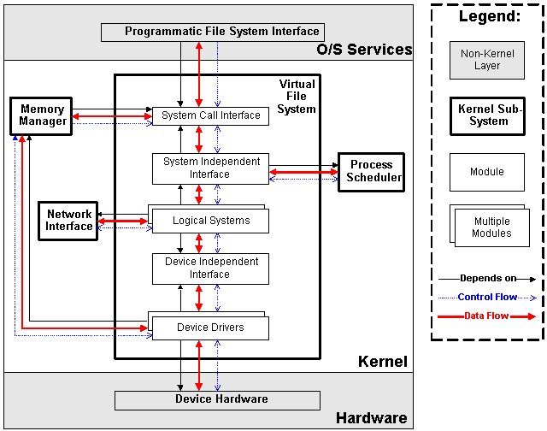
KERNEL
It is responsible for interfacing all of your applications that are running in “user mode” down to the physical hardware.

Slide 21
BOOTING PROCESS
BIOS
Basic Input/Output System executes MBR
MBR
Master Boot Record
Executes GRUB
GRUB
Grand Unified Boot Loader
Executes kernel
KERNEL
Kernel executes /sbin/init
Init
Init executes runlevel programs
Runlevel
Runlevel programs are executed from /etc/rc.d/rc*.d/

Slide 22
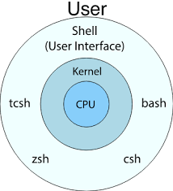
SHELL
Shell is an environment in which we can run our commands, programs, and shell scripts.

Slide 23
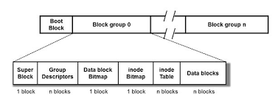
FILE SYSTEM
File System
Ext 2
Ext 3
Ext 4
Types of Journaling:
Write back
Ordered
Data

Slide 24
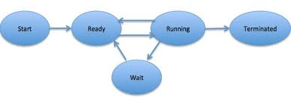
PROCESS MANAGEMENT
Types of Processes
Types of Process Scheduling
Init Process
FCFS (First Come First Serve)
Parent Process
SJC (Shortest Job First)
Child Process
Round Robin
Zombie Process
Priority Scheduling
Orphan Process
Interactive Process
Daemon Process
Real-time Process

Slide 25
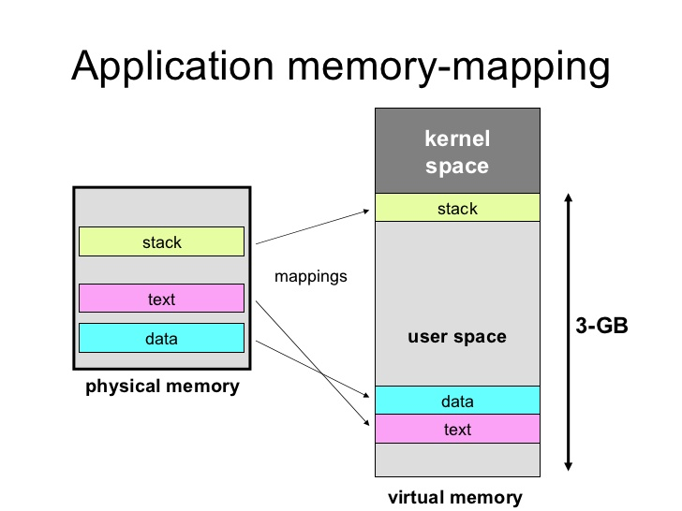
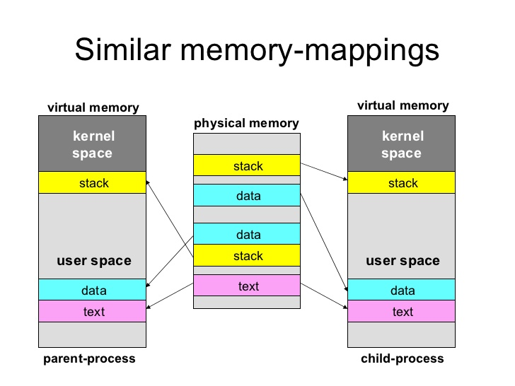
MEMORY MANAGEMENT

Slide 26
Network Fundamentals

Slide 27
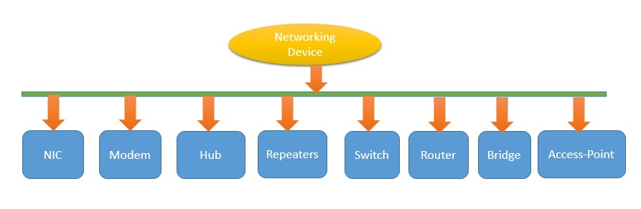
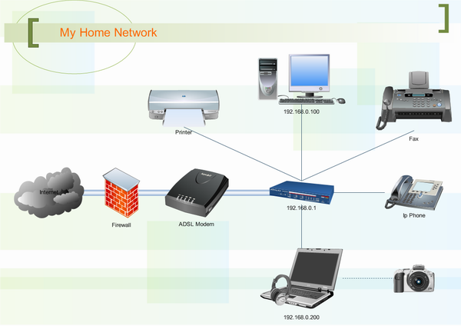
NETWORKING
It is a digital telecommunications network which allows nodes to share resources.

Slide 28
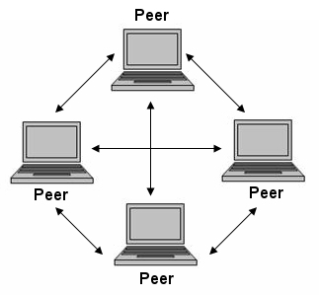
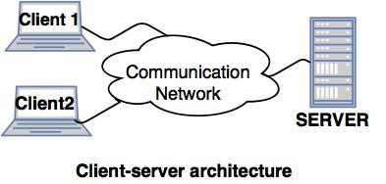
NETWORK ARCHITECTURE
Peer-to-peer
Client server

Slide 29
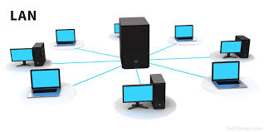
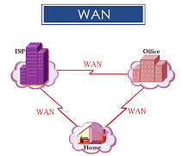
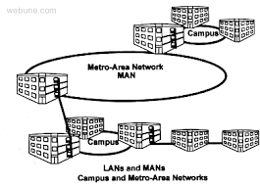
NETWORK TYPES

Slide 30
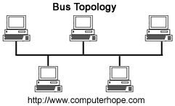
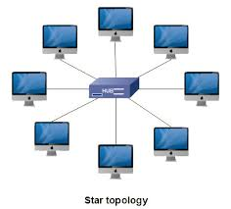
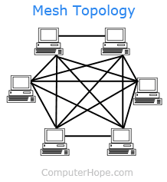
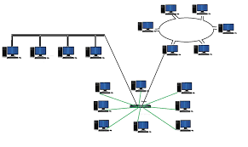
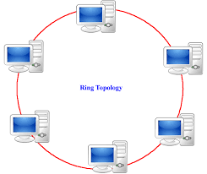
TYPES OF TOPOLOGIES
Bus topology
Star topology
Mesh topology
Hybrid topology
Ring topology

Slide 31
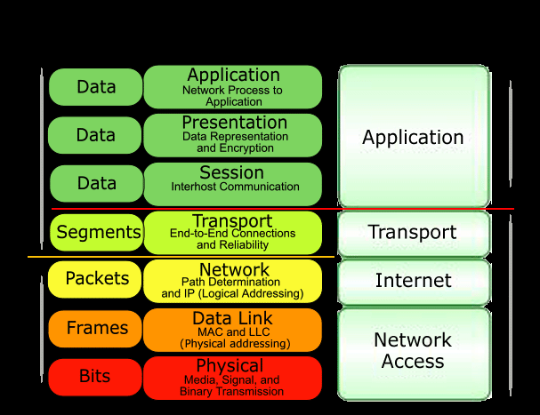
LAYERS WITH TCP\IP AND OSI MODEL

Slide 32
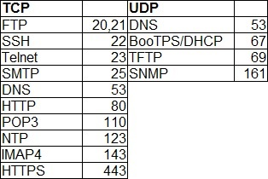
PROTOCOL
Protocol is a set of rules describes how data is transmitted over a network.
Protocols are needed for communication between any two devices.

Slide 33
IP Version
INTERNET PROTOCOL (IP) ADDRESS
IP
IPv4
IPv6
IPv4 addresses are 32 bit length.
IPv4 addresses are represented in decimals.
DHCP is required to configure IPv4 addresses.
IPv4 addresses are 128 bit length.
IPv4 addresses are represented in hexadecimals.
Auto-configuration of addresses is available.

Slide 34
Network Services

Slide 35
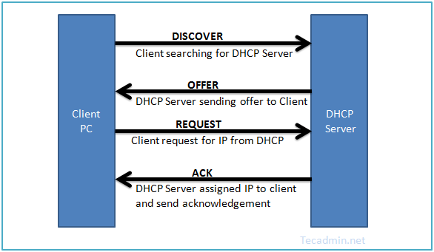
DHCP
Dynamic Host Configuration Protocol (DHCP) is a network protocol that enables a server to automatically assign an IP address to a computer from a defined range of numbers configured for a given network.

Slide 36
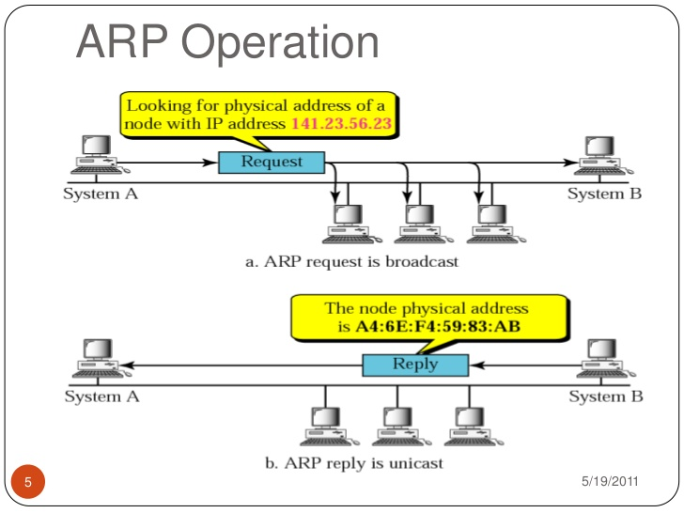
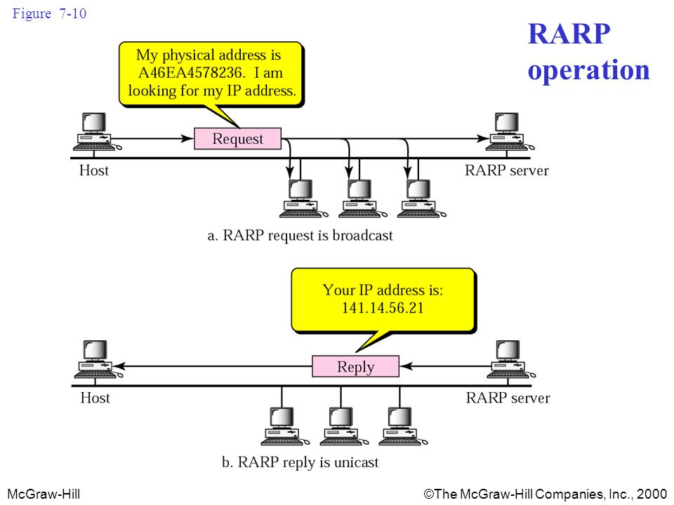
DHCP

Slide 37
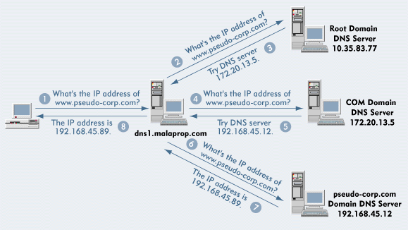
DOMAIN NAME SERVICE (DNS)
The Domain Name System is used to resolve human-readable hostnames like www.pseudo-corp.com into machine-readable IP addresses like 204.13.248.115.

Slide 38
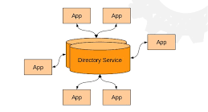

DIRECTORY SERVICES
LDAP

Slide 39

MAIL SERVICES
Electronic Mail (email or e-mail) is a method of exchanging messages ("mail") between people using electronic devices.
COMPONENTS OF MAIL SYSTEM:
MTA
MUA
MDA
SMTP
POP3
IMAP4

Slide 40



Proxy Server
Open Proxy
Forward Proxy
Reverse Proxy

Slide 41
DATABASE MANAGEMENT

Slide 42

DATABASE
A database is a collection of information that is organized so that it can be easily accessed, managed and updated.

Slide 43

DBMS
A database-management system (DBMS) is a computer-software application that interacts with end-users, other applications, and the database itself to capture and analyze data.

Slide 44
EF CODD RULES
Rule 1: Information Rule
Rule 2: Guaranteed Access Rule
Rule 3: Systematic Treatment of NULL Values
Rule 4: Active Online Catalog
Rule 5: Comprehensive Data Sub-Language Rule
Rule 6: View Updating Rule
Rule 7: High-Level Insert, Update, and Delete Rule
Rule 8: Physical Data Independence
Rule 9: Logical Data Independence
Rule 10: Integrity Independence
Rule 11: Distribution Independence
Rule 12: Non-Subversion Rule

Slide 45

NORMALIZATION
Normalization is a process of organizing the data in database to avoid data redundancy, insertion anomaly, update anomaly & deletion anomaly.
TYPES OF NORMALIZATION
First normal form (1NF)
Second normal form (2NF)
Third normal form (2NF)
Boyce Codd normal form (BCNF)

Slide 46






GENERAL ARCHITECTURE OF DBMS:
DIFFERENT DBMS PRODUCT:

Slide 47
APPLICATION MANAGEMENT

Slide 48


APPLICATION
An Application is a computer program designed to help people perform an activity.
COMPONENTS OF APPLICATION
LIFE CYCLE OF AN APPLICATION

Slide 49


APPLICATION ARCHITECTURE
Thick client architecture
Thin client architecture
Rich internet application

Slide 50



Tiers

Slide 51
STORAGE

Slide 52


TOPOLOGIES

Slide 53

STORAGE TYPES
Notes:
2

Slide 54





Slide 55



Slide 56
Thank You

